Slide 1
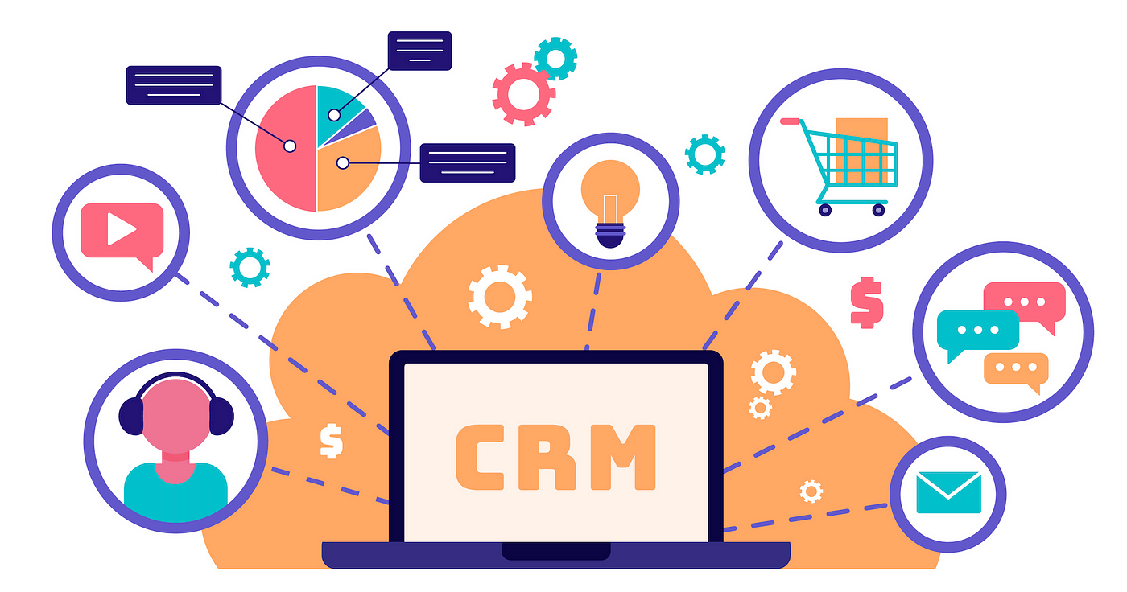
Suchi Sharma
10-09-24
Customer Segmentations Analysis for CRM

Slide 2
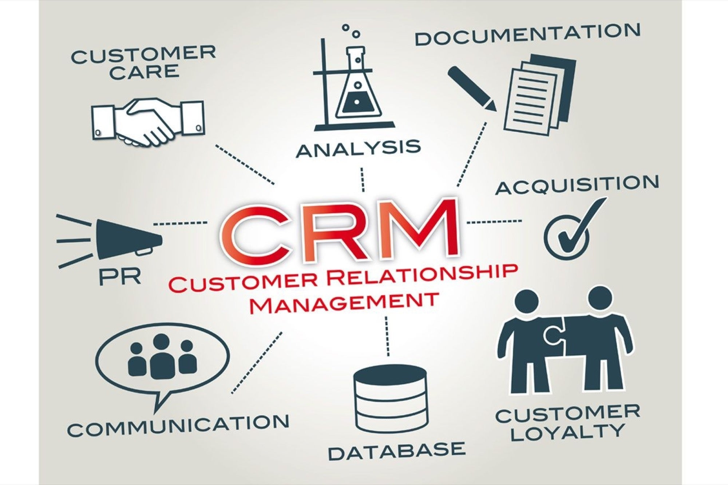
Introduction to CRM Analysis
Introduction to CRM Analysis
CRM analysis focuses on understanding and enhancing
interactions with customers. CRM can be optimised through
customer segmentation. By analysing Recency, Frequency, and
Monetary metrics, we identify key customer segments to tailor
marketing strategies and enhance engagement.
By segmenting customers based on their purchase
behaviour, businesses can:
Identify Key Customer Segments: Determine which customers are most valuable.
Personalise Marketing Efforts: Tailor campaigns to meet the needs of different customer groups.
Optimise Business Strategies: Allocate resources effectively based on customer value and behaviour.
In this analysis, we use Recency, Frequency, and Monetary (RFM) metrics to segment customers, providing actionable insights for improving customer engagement and driving business growth.

Slide 3
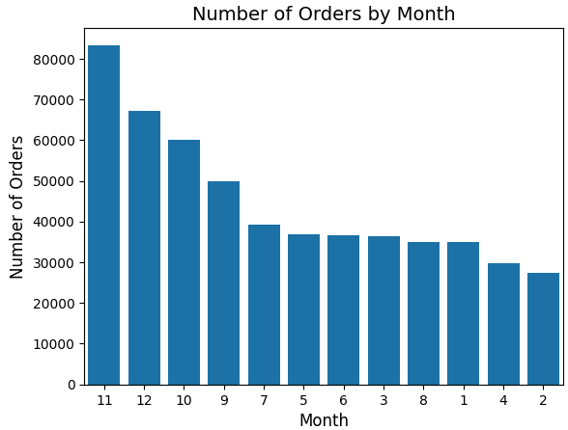
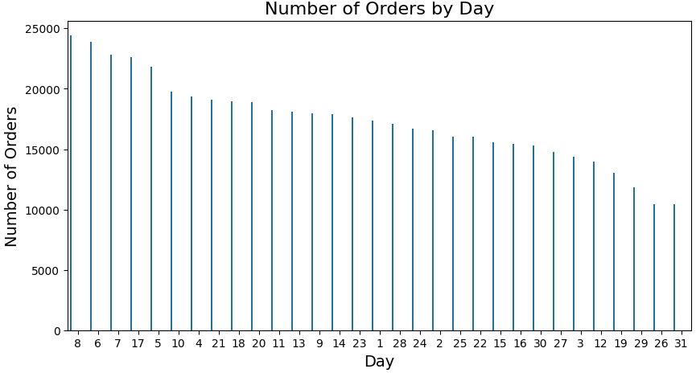
Order Summary
Number of Orders by Month Insights:
1. Peak Month: November has the highest number of orders,
exceeding 80,000. This suggests high activity during the holiday
shopping season.
2. Steady Decline: After November and December, there is a
steady decline in the number of orders, with the lowest numbers
observed in February.
3. Lowest Months: February and April show the least number
of orders, indicating possible seasonality in purchasing behaviour.
Number of Orders by Day Insights :
Busy Early Days: The 8th and 6th days of the month
have the most orders, around 24,000.
2. Gradual Decline: As the days progress, the number of
orders steadily declines.
3. End-of-Month Drop: The lowest number of orders
occurs on the last few days of the month (29th-31st), likely
due to budgeting or pay cycle patterns.

Slide 4
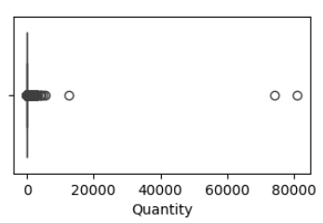
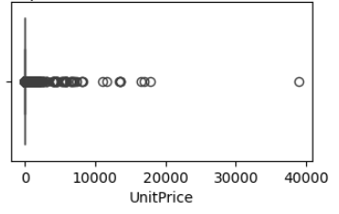
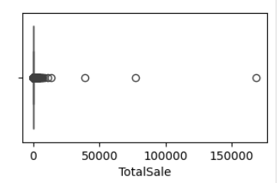
Outlier Detection
Quantity:
Extreme outliers with values above 80,000.
Most transactions involve much lower quantities, indicating possible bulk orders or errors.
UnitPrice:
Outliers reach up to 40,000, suggesting high-priced items or data issues.
Majority of items are low-cost, as prices are clustered at the lower end.
TotalSale:
Large outliers with sales reaching 150,000.
Most transactions have smaller totals, with outliers indicating bulk purchases or anomalies.

Slide 5
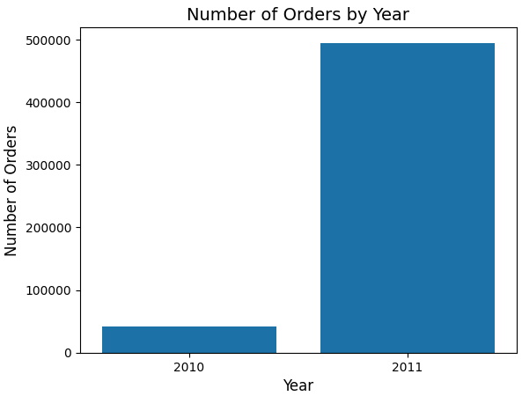
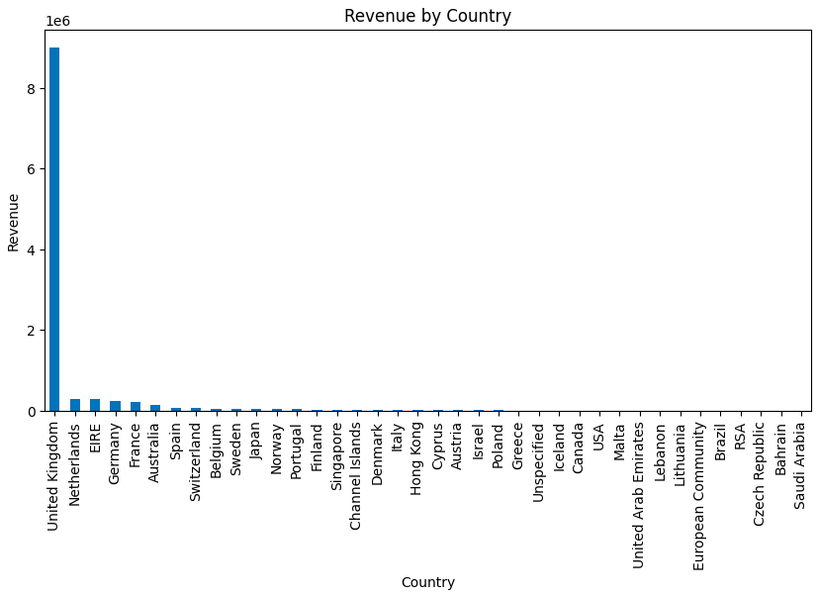
Order Summary
Number of Order by Year Insights :
1. Significant growth in the number of order from 2010 to 2011.
2. Order in 2011 are almost 5X higher, indicating rapid business
expansion or increased customer demand during that period.
Revenue by Country Insights :
The United Kingdom dominates in
revenue, contributing more than 8 million,
far surpassing other countries.
2. Countries like the Netherlands,
Germany, France, and Australia show
minor contributions in comparison, suggesting
heavy reliance on the UK market.

Slide 6
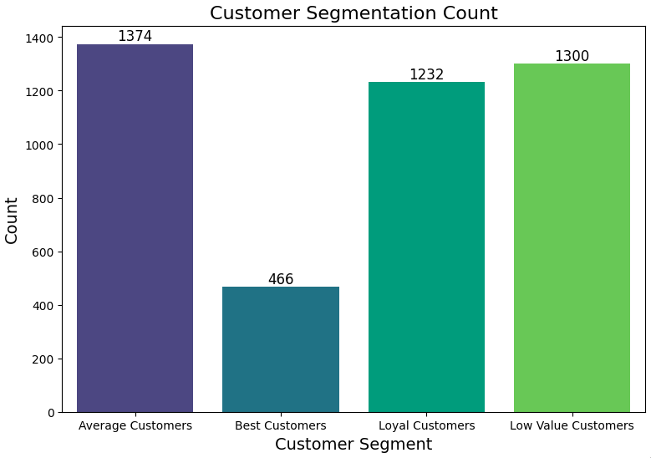
Customer Segmentation Analysis using RFP
Average Customers (1374):
This segment represents the bulk of your customer base. These are customers with average engagement and spending patterns, contributing moderately to the business.
Best Customers (466):
A small but highly valuable group. These customers are the most loyal, with high spending, and likely to generate the most revenue. Focused efforts to retain and reward this group can maximize long-term value.
Loyal Customers (1232):
This segment indicates customers who consistently return. They may not spend as much as the "Best Customers," but their repeat purchases add stability and predictability to revenue streams. Building stronger relationships with this group can elevate them to "Best Customers."
Low Value Customers (1300):
Although sizeable, this group contributes the least to revenue. They may make infrequent or small purchases. Efforts like targeted promotions or re-engagement campaigns could help improve their value or transition them to higher segments.

Slide 7
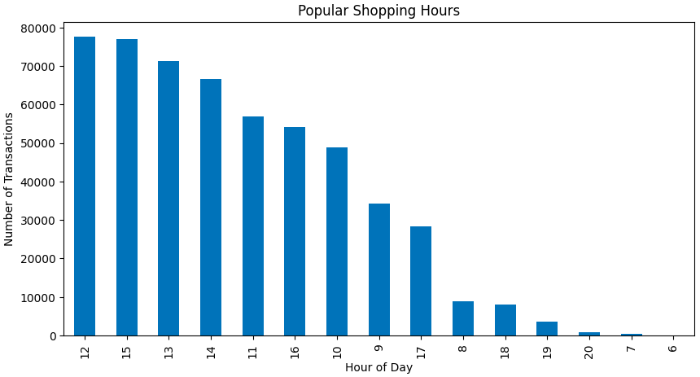
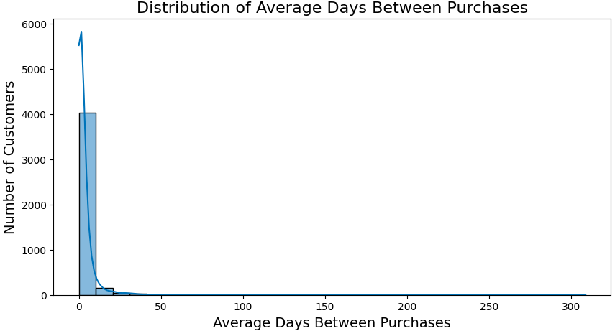
Insights
Popular Shopping Hours Insights :
Peak Hours: The highest number of transactions happen
between 12 PM to 3 PM, with the most transactions
occurring around 12 PM and 1 PM.
Late Afternoon Decline: After 3 PM, there's a
noticeable decline in transactions, especially after 4 PM, which
continues through the rest of the day.
Low Activity Hours: Early morning (before 10 AM)
and late evening (after 6 PM) see the least shopping activity,
with very few transactions during these hours.
Distribution of Average Days Between Purchases Insights :
Highly Frequent Purchases: A significant number of customers
tend to make purchases within a short period, as the distribution is
heavily skewed to the left (0-5 days).
Long-Tail Distribution: There is a long tail, meaning a few
customers have a large gap between purchases (up to 300+ days),
but these instances are rare.
Key Observation: The majority of customers seem to return
within 0-10 days for their next purchase, indicating frequent repeat
buyers.

Slide 8
Insights and Recommendations
1. Sales Performance
Revenue Trends: The data indicates a significant revenue increase in 2011 compared to 2010, suggesting strong growth potential. However, it’s crucial to analyze the reasons behind this growth to sustain it.
Outlier Detection: The presence of outliers in the Quantity, UnitPrice, and TotalSale indicates potential anomalies or unique sales scenarios. Investigating these can help identify exceptional customer behaviours or issues in pricing strategies.
2. Customer Demographics
Customer Base Composition:
The data shows a wide range of unique products and high sales volume predominantly from the United Kingdom. Focusing on this market for tailored promotions can enhance customer engagement.
The average number of customers is substantial, but segments indicate a disparity in value contribution. The segment of Best Customers is relatively small but valuable, while Low Value Customers constitute a significant portion.
3. Customer Segmentation
Segmentation Analysis:
The segmentation highlights opportunities for targeted marketing strategies. Best Customers should be rewarded and engaged further, while Loyal Customers can be incentivised to increase their spending.
Low Value Customers represent an opportunity for growth. Implementing strategies to re-engage them could potentially elevate their value.
4. Popular Shopping Hours & Distribution of Average Days Between Purchases
Peak Shopping Hours: Most transactions occur between 12 PM and 3 PM, with significantly fewer transactions outside of these hours.
Frequent Repeat Purchases: Many customers return to shop within 0-10 days after their last purchase, with very few customers having large gaps between purchases.
5. Number of Orders by Month & Day
November Peak: The highest number of orders are placed in November, likely due to holiday shopping.
Daywise Ordering Trends: The first half of the month, particularly the 6th to 8th, sees more activity, while the end of the month sees a decline in orders.
Seasonal Drop: February and April are the slowest months for orders.
Recommendations:
Develop programs that reward Best and Loyal Customers to enhance retention and encourage higher spending.
Create tailored campaigns for Low Value Customers with incentives to increase purchase frequency and average transaction value.
Conduct a thorough analysis of outliers in the sales data to understand their impact and potentially replicate successful strategies used in those transactions.
Since a significant portion of revenue comes from the UK, consider diversifying into other markets by analyzing purchasing trends in countries with lower revenue but potential customer bases.
Implement a regular review process to monitor customer behavior and sales trends, allowing for timely adjustments to strategies as market conditions change.
Increase promotions and special offers during 12 PM to 3 PM to capture high traffic.
Offer incentives during off-peak hours (early morning or late evening) to distribute shopping activity more evenly throughout the day.
Implement a customer loyalty program to reward frequent buyers, as the data shows a high volume of customers returning within 10 days.
Send targeted reminders or follow-up promotions to encourage repeat purchases within the first 5-10 days of a customer's last order.
November is the highest-performing month; capitalize on this by launching holiday-specific campaigns and offering early-bird deals starting in October.
During slower months (e.g., February and April), offer seasonal discounts or clearance sales to maintain steady order flow.
Since the 6th to 8th days of the month are particularly busy, align major product launches or promotions to these dates.
Offer end-of-month deals to stimulate purchases during the typically slower period of the 29th-31st.the month with special offers.

Slide 9

Thank You

